Slide 1
Web development basics
CSS specificity, responsiveness, transitions, animations

Slide 2
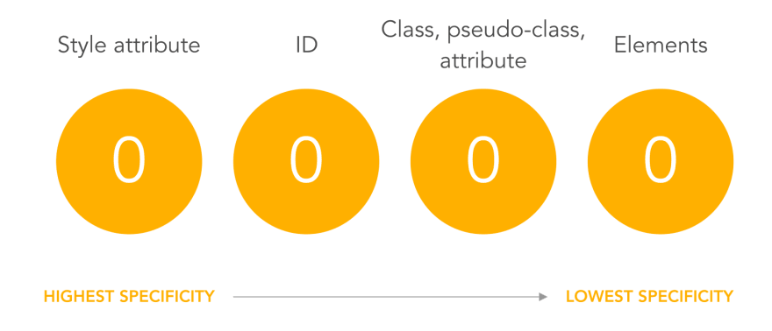
CSS specificity

Slide 3
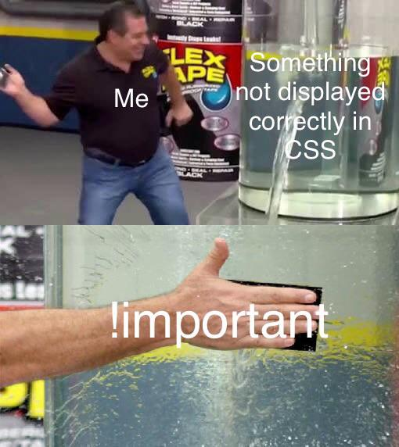
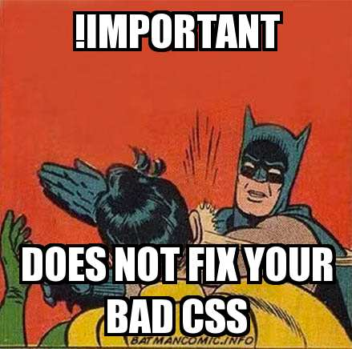
CSS specificity !important

Slide 4
CSS flexbox
CSS Flexbox is a layout module in CSS that makes it easy to create flexible, responsive layout structures without using floats or positioning. It allows you to align elements horizontally and vertically, distribute space between elements, and reorder elements within a container. Flexbox is particularly useful when creating responsive design, as it allows you to control how elements are displayed on different screen sizes and orientations. To use flexbox, you first create a container element and set its display property to "flex". Then, you can use various flexbox properties to control the layout of the child elements within that container.

Slide 5
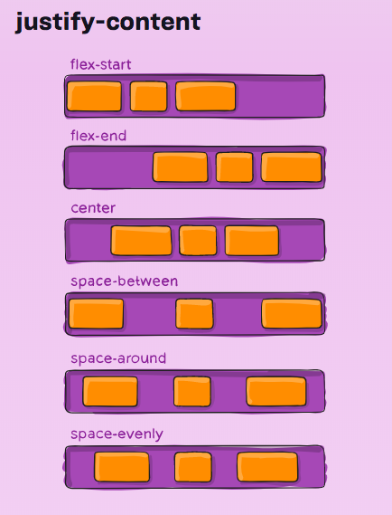
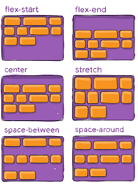

CSS flexbox 2

Slide 6
CSS grid
CSS Grid is a two-dimensional layout system for the web that allows you to create rows and columns to organize elements on a webpage. It is designed to make it easy to create complex, responsive layouts with minimal code. With CSS Grid, you can define a grid container and then specify how many rows and columns the grid should have, and how the elements within the grid should be placed. You can also control the size of rows and columns, and specify how elements should span multiple rows or columns. CSS Grid also allows you to control the alignment of elements within the grid and how the grid should respond when the viewport size changes.
One of the main advantages of CSS Grid is that it allows you to create layouts that are not possible with traditional CSS techniques such as floats and positioning. Grid also make it easy to create responsive design as it allows you to control how elements are displayed on different screen sizes and orientations.
To use CSS Grid, you first create a container element and set its display property to "grid". Then, you can use various grid properties to define the structure of the grid and the placement of the child elements within it.

Slide 7
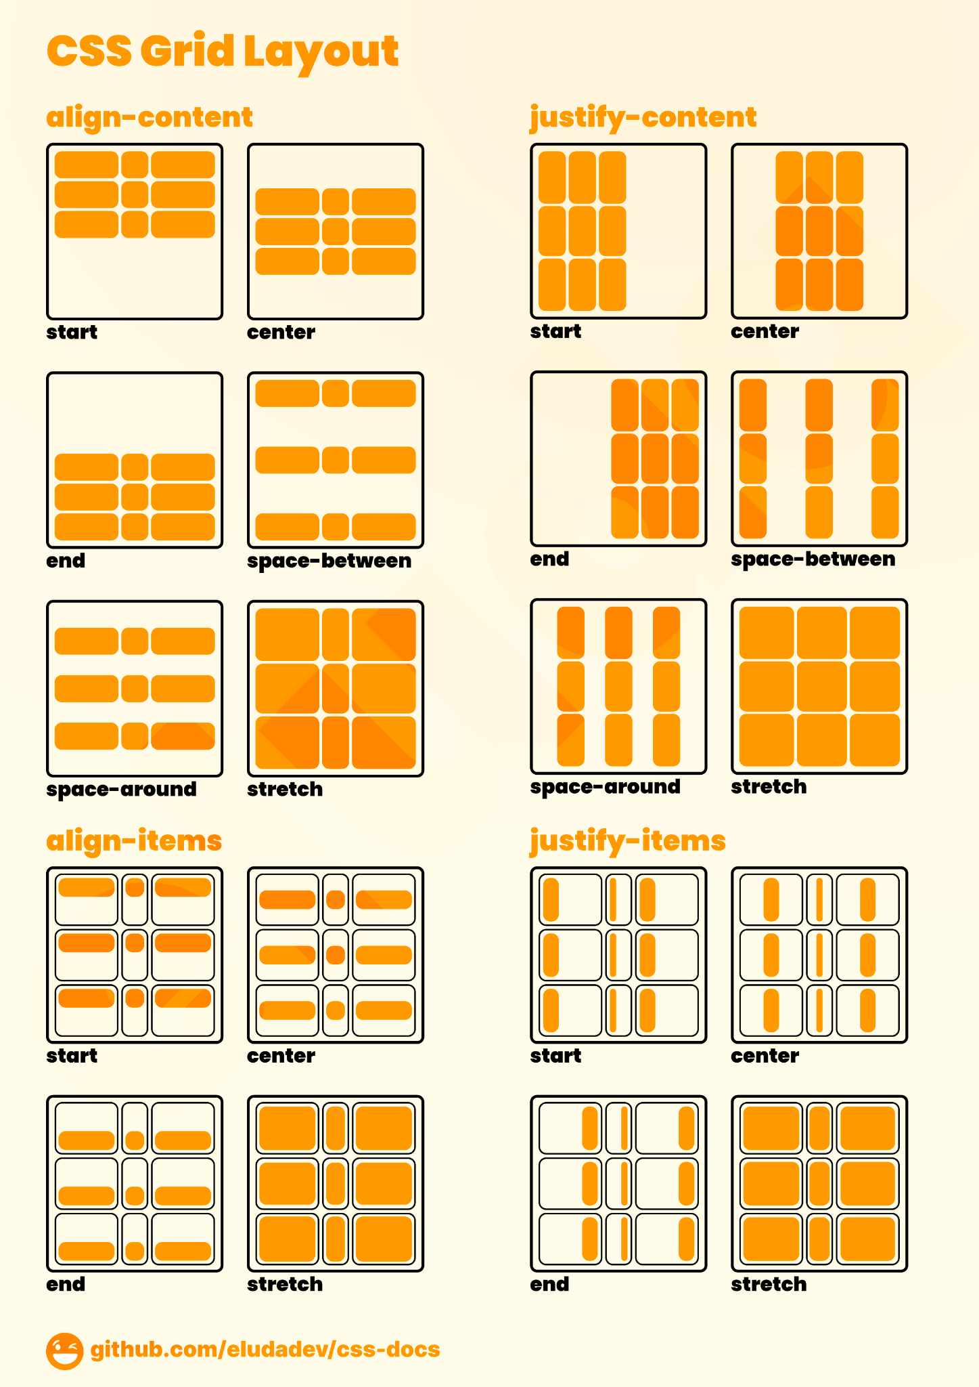
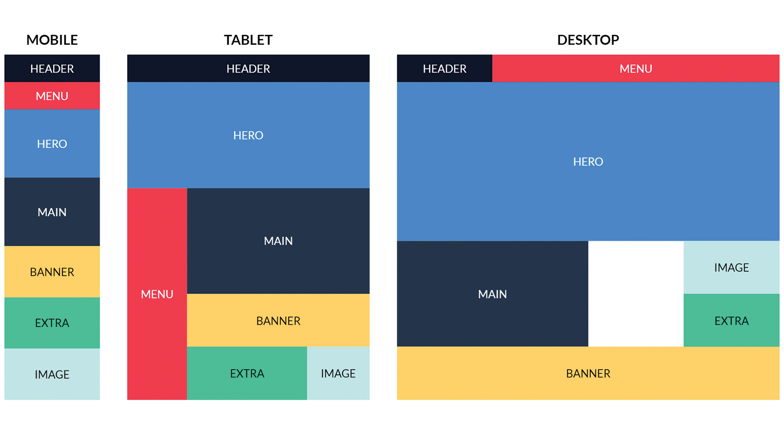
CSS grid 2

Slide 8
CSS flex classwork
Create an HTML file with a nav element to serve as the navigation bar container.
Inside the nav element, create a list of a elements to represent each navigation item.
Set the nav element's display property to flex and its justify-content property to space-between to evenly distribute the navigation items across the container
Add styles to the a elements to make them look like navigation items (e.g. display as block elements and give them padding and a background color).
Use media queries to adjust the flex-direction property of the nav element to change the orientation of the navigation items on different screen sizes (optional)
Preview your changes in the browser and adjust the styles as needed.

Slide 9
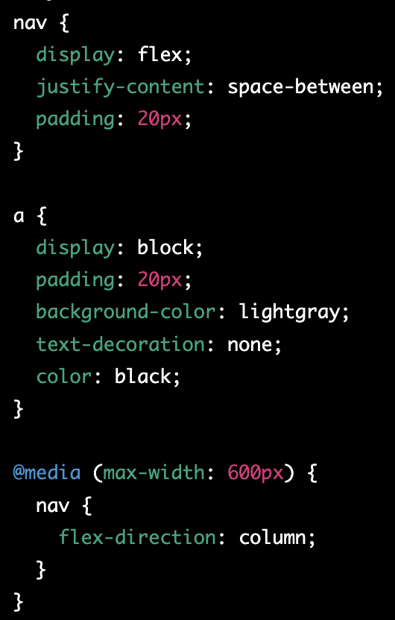
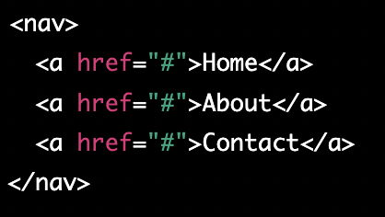
CSS flex classwork - solution

Slide 10
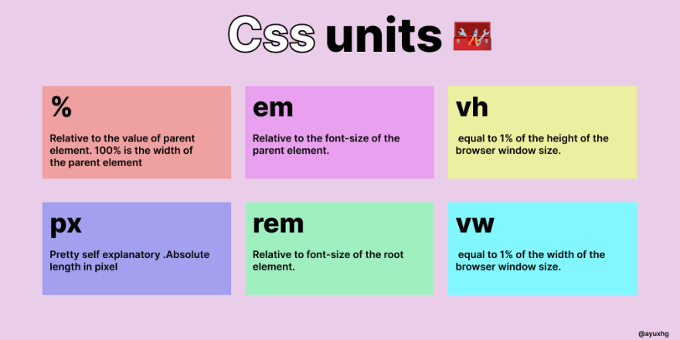
CSS Measurements

Slide 11
CSS Position
Static: This is the default value of the position property, and it means that the element is positioned according to the normal flow of the document. Elements with position: static are not affected by the top, right, bottom, and left properties.
Relative: This value positions the element relative to its normal position in the document flow. Setting top, right, bottom, or left properties will move the element in the respective direction from its original position.
Absolute: This value positions the element relative to its nearest positioned ancestor (ancestor elements with a position value other than static). If there is no positioned ancestor, then the element is positioned relative to the initial containing block (usually the <html> element).
Fixed: This value positions the element relative to the viewport (the visible area of the browser window). Fixed elements are always visible, even when the user scrolls the page.
Sticky: This value is a hybrid of relative and fixed positioning. A sticky positioned element is positioned relative to its nearest positioned ancestor or the viewport. However, it behaves like a fixed element when it reaches a certain threshold (specified with top, right, bottom, or left), and then it sticks to that position.

Slide 12
CSS Pseudo-Classes
https://developer.mozilla.org/en-US/docs/Web/CSS/Pseudo-classes

Slide 13
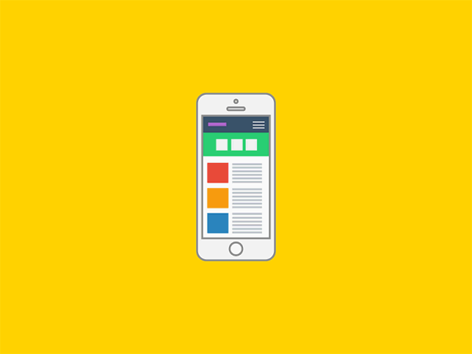
Responsive Design and Animation
Responsive design ensures that a website or application looks and functions correctly on a variety of devices, such as laptops, tablets, and smartphones. This is important because more and more people are accessing the internet on mobile devices, and a website that is not optimized for mobile may be difficult to navigate or use.
Animation can help to guide the user through the interface and make the experience more engaging. For example, animation can be used to highlight important information, provide feedback on user interactions, and create a sense of hierarchy on the page. Additionally, animation can make a website or application feel more dynamic and alive, which can lead to a more positive user experience.

Slide 14
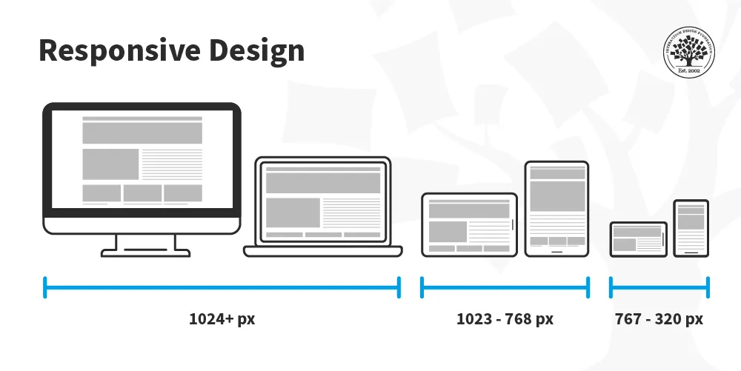
What is Responsive Design?
Responsive design is a method of designing and developing websites and applications that adapt to the size of the user's screen. This allows the website or application to look and function correctly on a variety of devices, such as laptops, tablets, and smartphones.
One key aspect of responsive design is the use of media queries, which are a way to apply CSS styles based on the characteristics of the device. Media queries allow designers to create different layouts for different screen sizes, so that the content can be rearranged and resized to fit the screen.

Slide 15
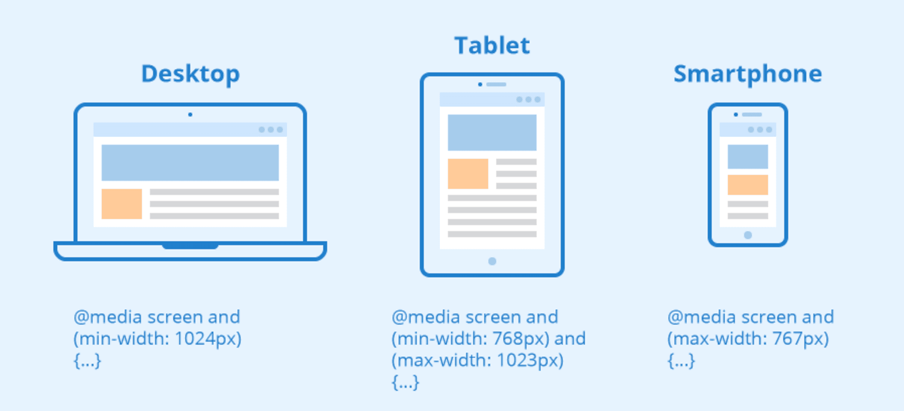
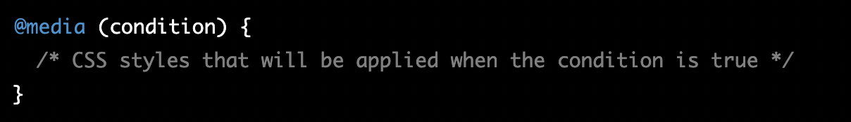
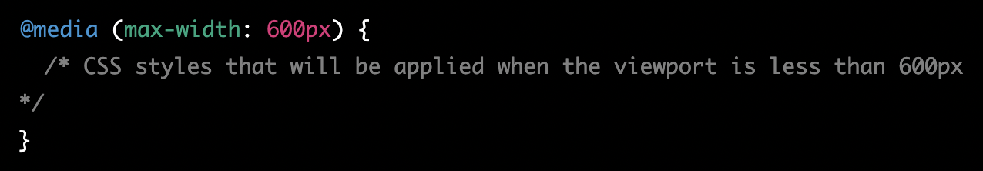
CSS media queries
By using media queries, designers can create websites and applications that adapt to the size of the user's screen, ensuring that the content is always easy to read and navigate, regardless of the device being used.

Slide 16
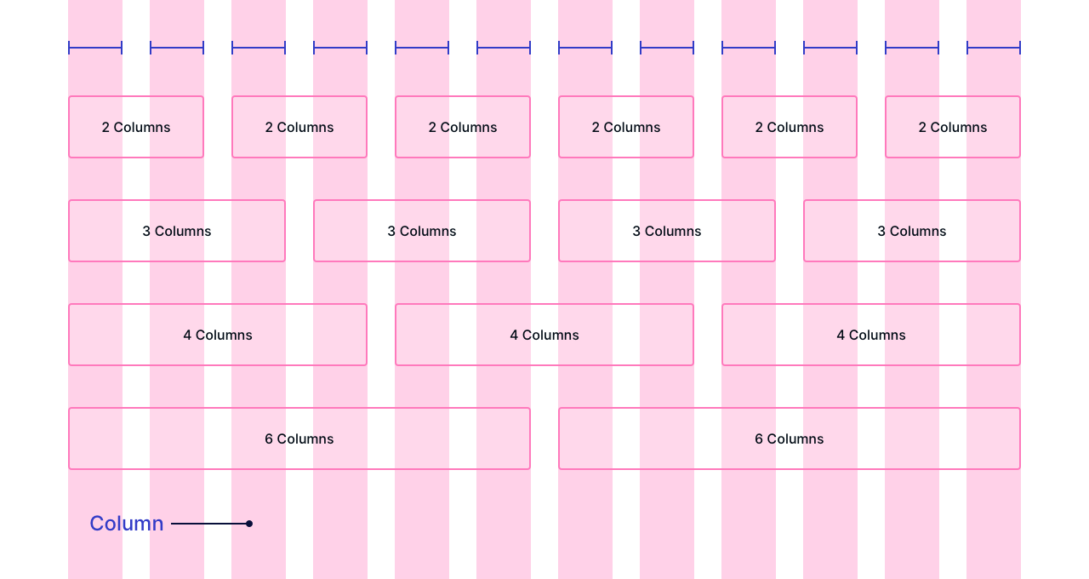
Fluid grids
Another important aspect of responsive design is the use of fluid grids, which are a way to create layouts that automatically adjust to the size of the screen. This is done by defining the layout in terms of relative units, such as percentages, rather than absolute units, such as pixels.
This allows the layout to automatically adjust to the size of the screen, so that the content can be rearranged and resized to fit the screen. Together, media queries and fluid grids allow designers to create websites and applications that adapt to the size of the user's screen, ensuring that the content is always easy to read and navigate, regardless of the device being used.

Slide 17
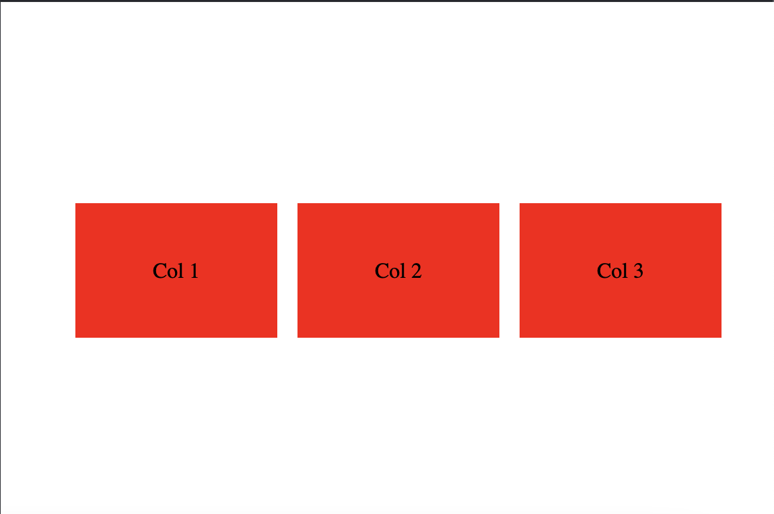
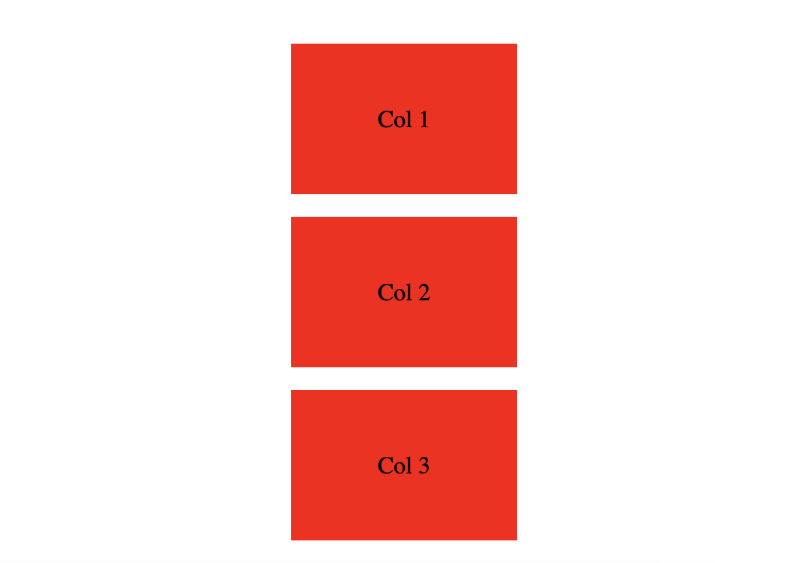
Using Media Queries to create Responsive Design
<div class="wrapper">
<div>Col 1</div>
<div>Col 2</div>
<div>Col 3</div>
</div>

Slide 18
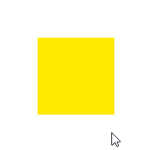
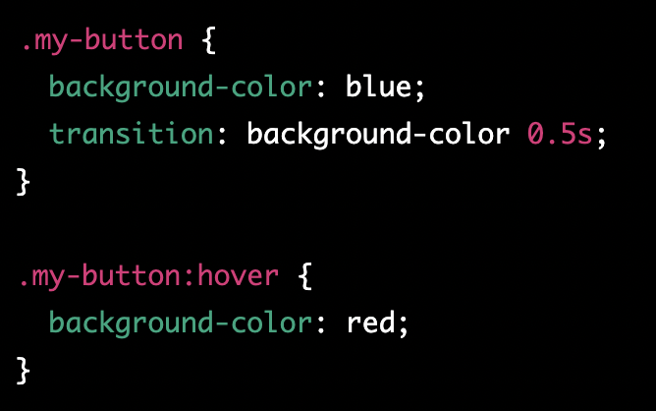

Creating Smooth Transitions with CSS
CSS transitions allow you to smoothly change the values of CSS properties over a given duration. They are used to add visual effects and make changes in the layout of a webpage look more natural.
https://www.w3schools.com/css/css3_transitions.asp

Slide 19
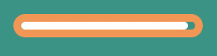
Introducing Animation to your website
Animation is the process of creating the illusion of motion by rapidly displaying a sequence of static images, called frames. When these frames are played back in quick succession, the human eye perceives them as a continuous motion. Animation can be used to create engaging and interactive user interfaces by providing visual feedback, guiding the user's attention, and creating a sense of motion and dynamism.

Slide 20
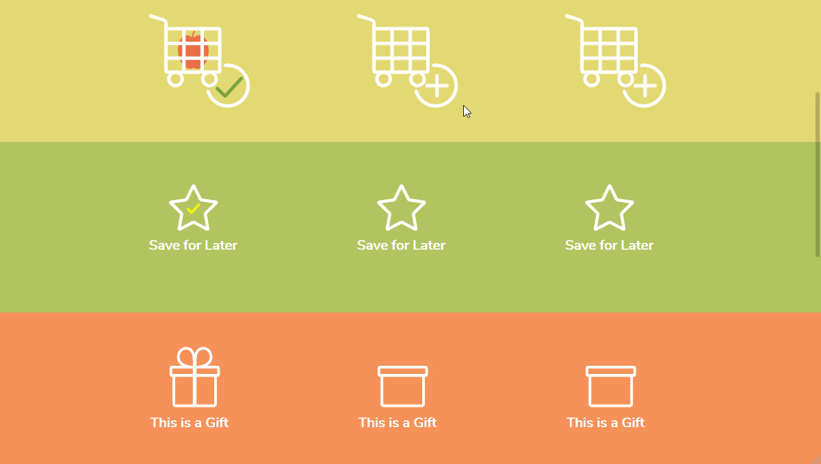
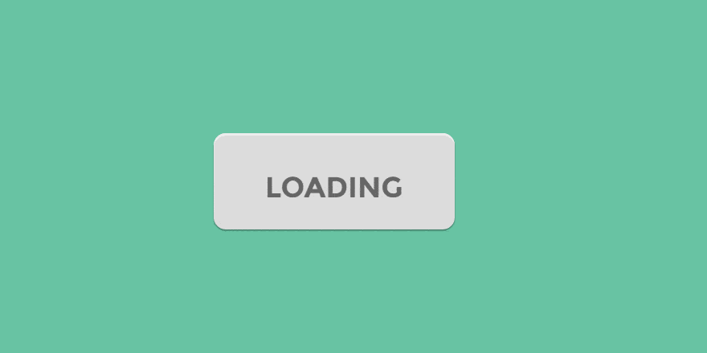
Animation use case examples
Animation can be used in a variety of ways to enhance the user experience. For example, an animation can be used to:
Provide visual feedback when a button is clicked or a form is submitted
Guide the user's attention by highlighting important elements on the page
Create a sense of motion and dynamism, making the interface feel more alive and engaging
…

Slide 21
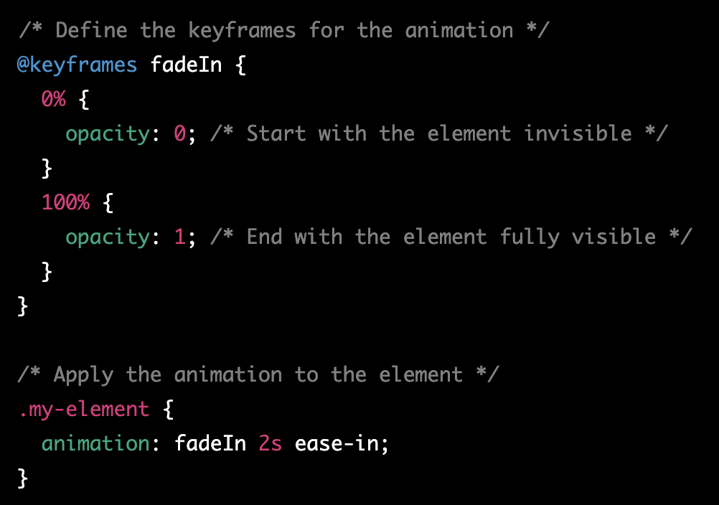
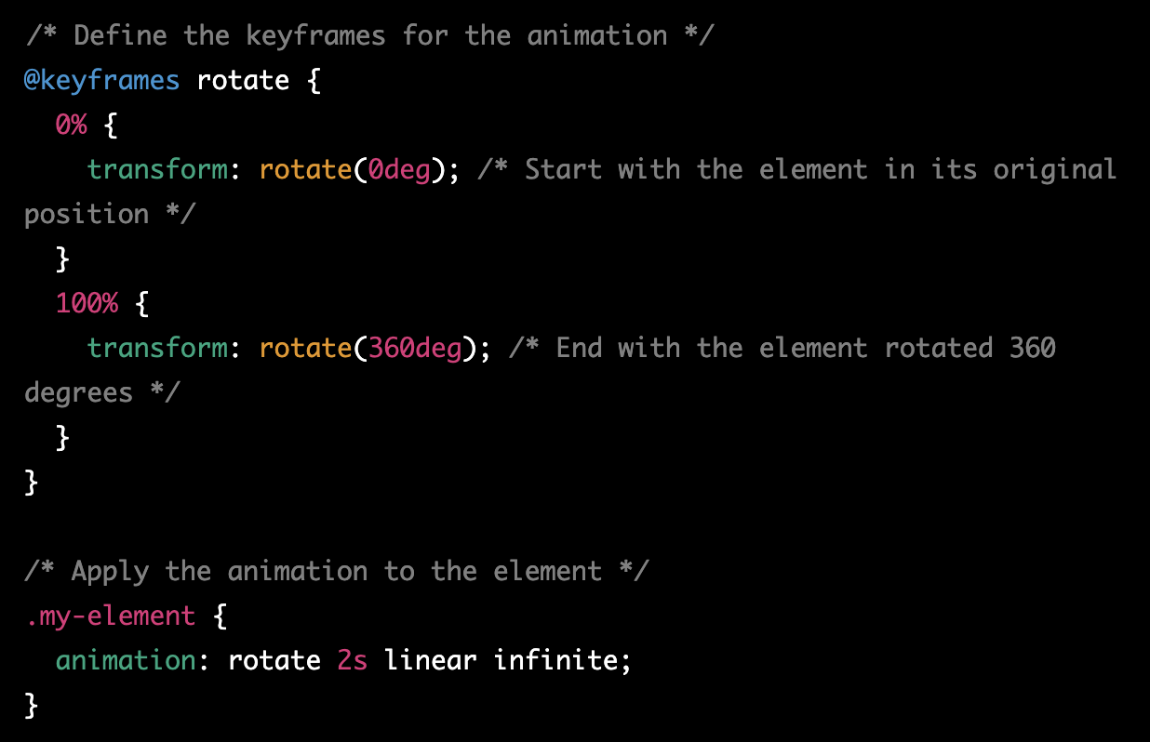
Creating Animations with CSS

Slide 22
Animations task
Task: Create a simple animation that makes a square move across the screen horizontally.
Steps:
Create the HTML structure for the square. In the body of your HTML file, add a div with the class "square"
In your CSS file, give the square a size and a background color
Define the keyframes for the animation. In your CSS file, create a new @keyframes rule called "move" that defines the starting and ending positions of the square:
Apply the animation to the square. Using the animation property, specify the animation name, duration, and timing function:
Test your animation by running the HTML file in a browser. The square should move horizontally across the screen from left to right over a duration of 2 seconds, using a linear timing function.

Slide 23

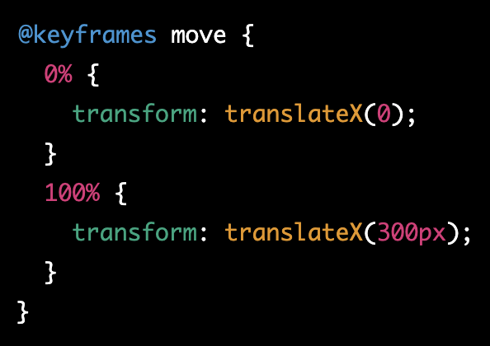
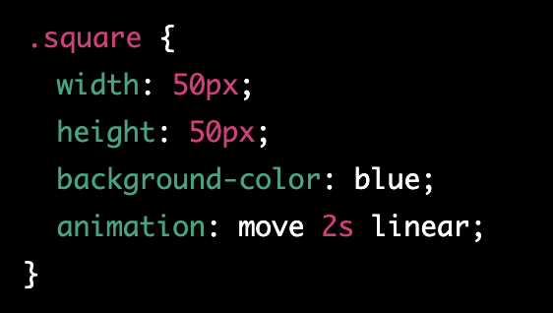
Animations task explanation

Slide 24
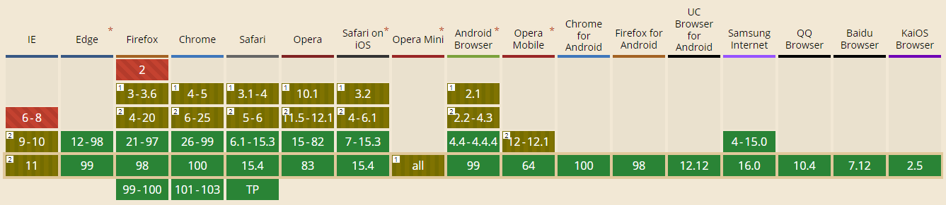
Can I use it?

Slide 25
Homework
Add responsiveness/transitions/animations to portfolio
Portfolio ideas - https://bashooka.com/html/free-html-css-portfolio-web-design-templates/

